Slide 1
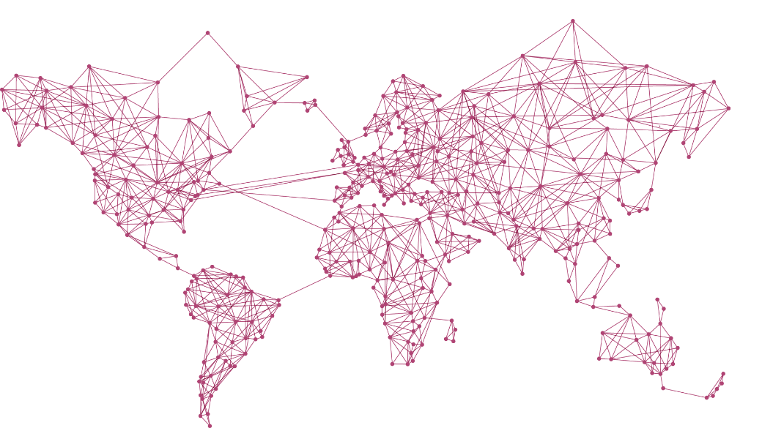
Main Results
Back-end
Front-end
MongoDB
Local Server
APIs: GDAX
Bitnode
Poloniex
Realtime Line Chart
Realtime Depth Chart
History Candle Chart
Comparison Realtime/History Line Chart
Bitnode Map

Slide 2
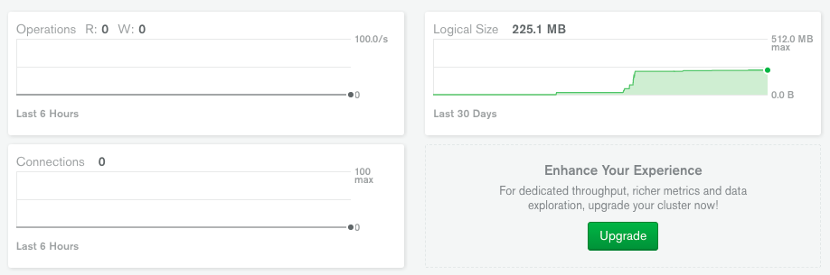
Back-end Activity

Slide 3
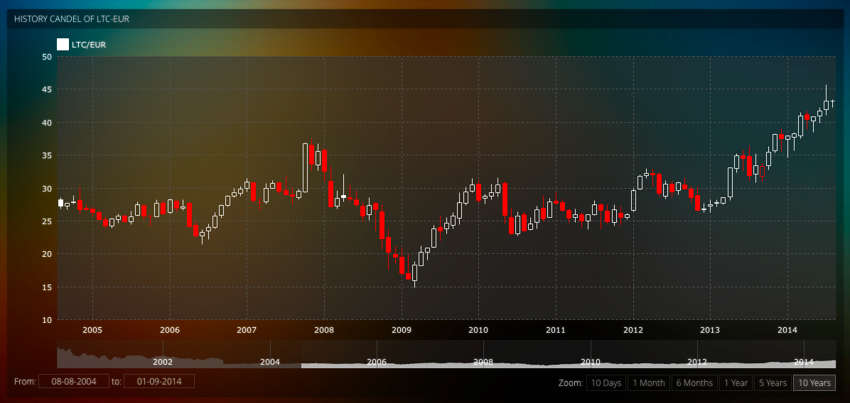
Front-end Chart

Slide 4
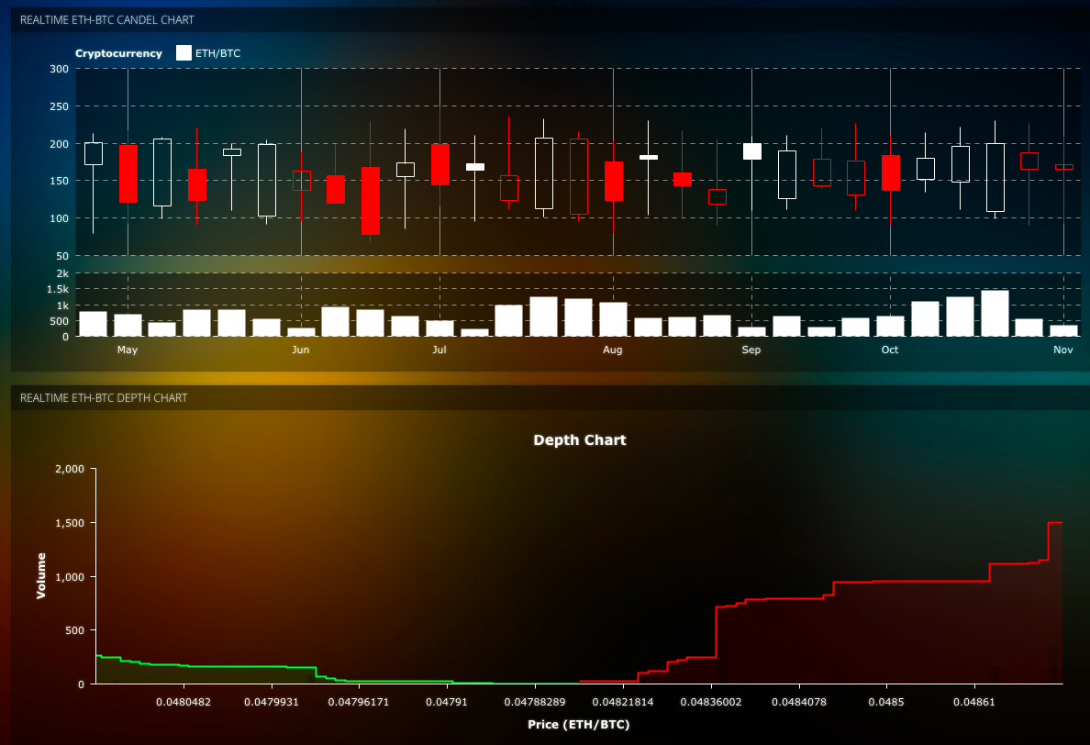
Front-end Chart

Slide 5
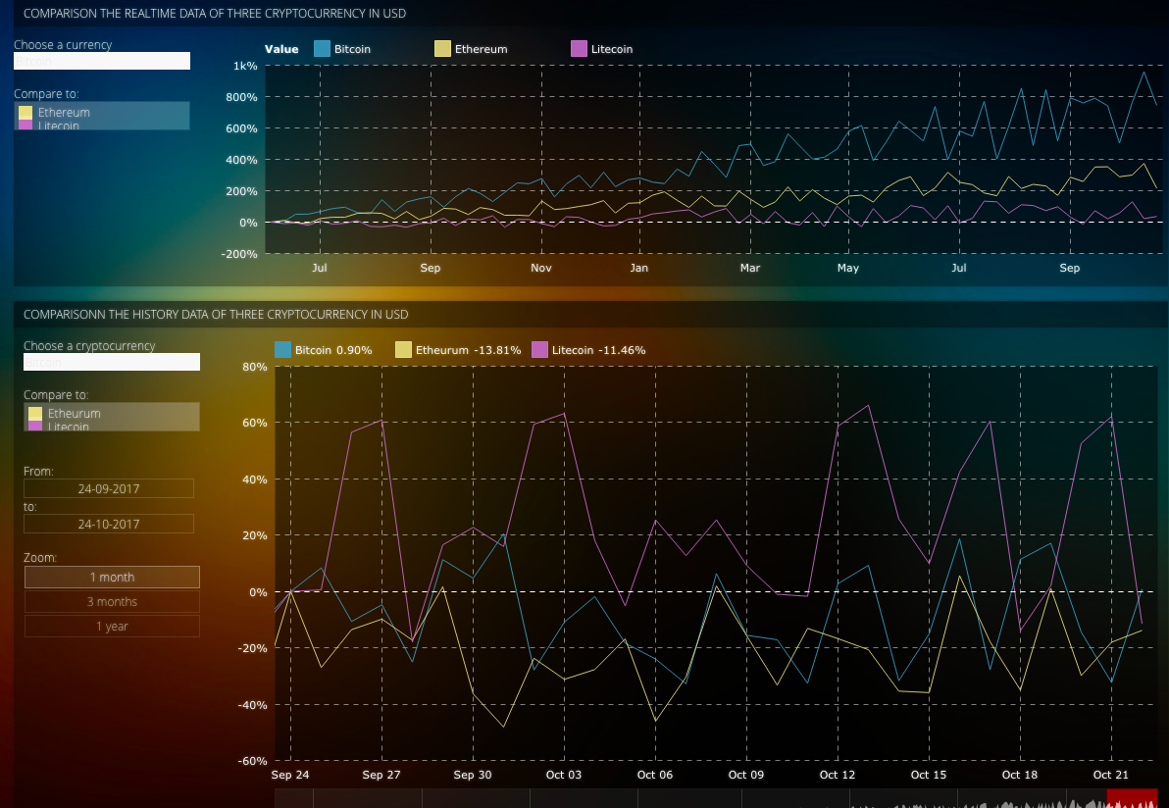
Front-end Chart

Slide 6
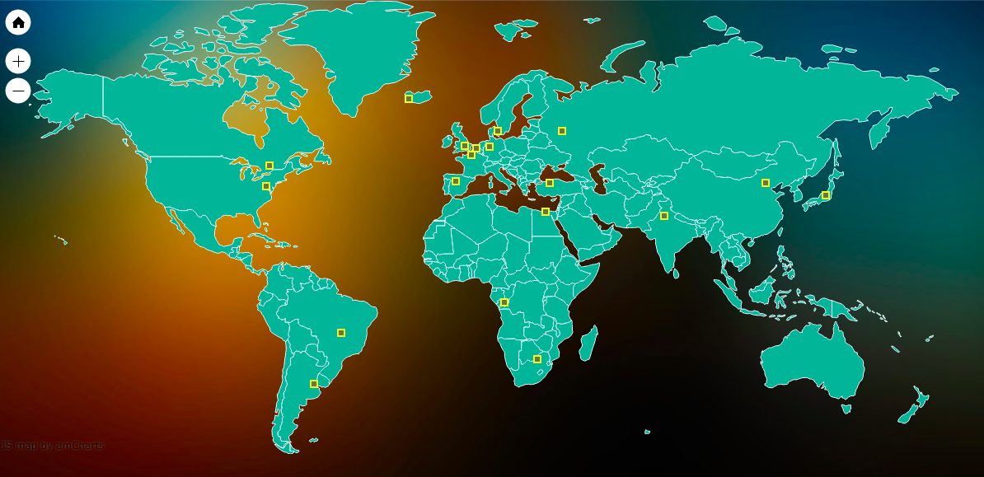
Front-end Chart

Slide 7
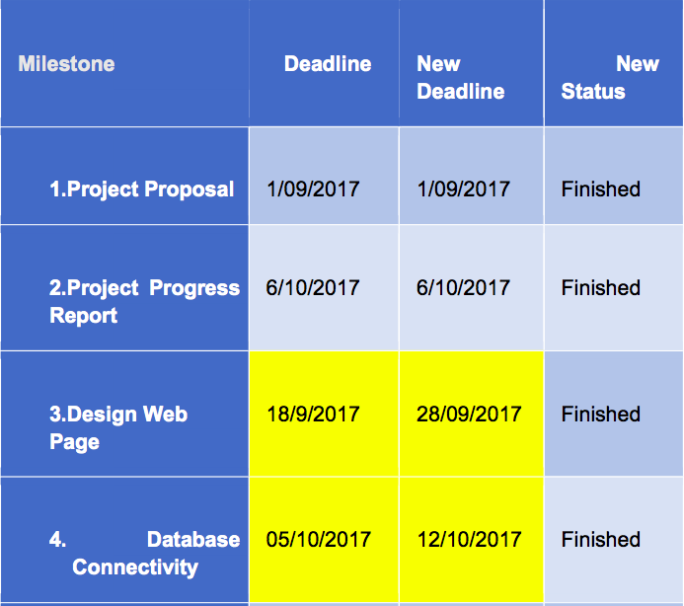
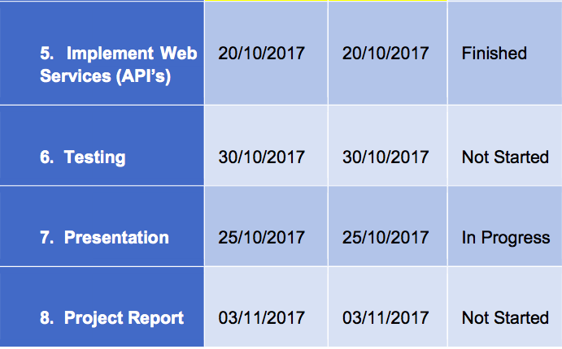
Discussion/Evaluate
On Time/On Scheme
Extra Work
Make Some Changes

